Slide 1
Daily Review
CFU 1
In an organism, what are tissues?
Cells → Tissues → Organs → Systems
Cells are the basic building block of life
Tissues are groups of cells with the same function
Organs are groups of tissues that work together
Systems are multiple organs working together
CFU 2
How is a tissue different to an organ?
CFU 3
What is the relationship between tissues and organs?

Slide 2
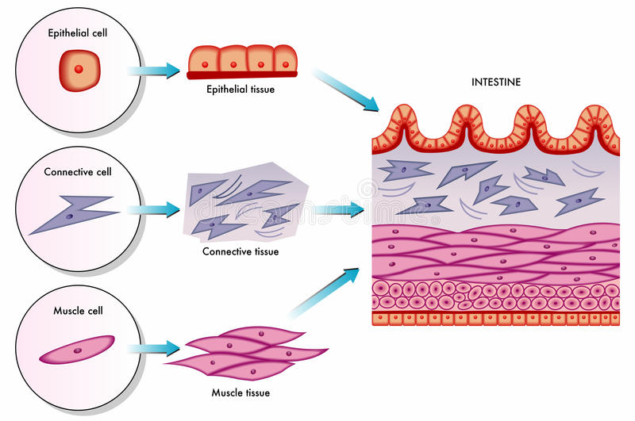
Daily Review
CFU 1
In this diagram, which letter represents tissues?
Cells → Tissues → Organs → Systems
A
B
CFU 2
In this diagram, which letter represents an organ?
C
CFU 3
Which system does this organ belong to?

Slide 3
Daily Review
Organs and Systems
For each organ below, match the organ to its system.
Organs Body System
1 Stomach A Digestive
2 Uterus B Respiratory
3 Heart C Excretory
4 Bladder D Nervous
5 Skull E Circulatory
6 Lungs F Musculoskeletal
7 Brain G Reproductive

Slide 4
Digestive System

Slide 5
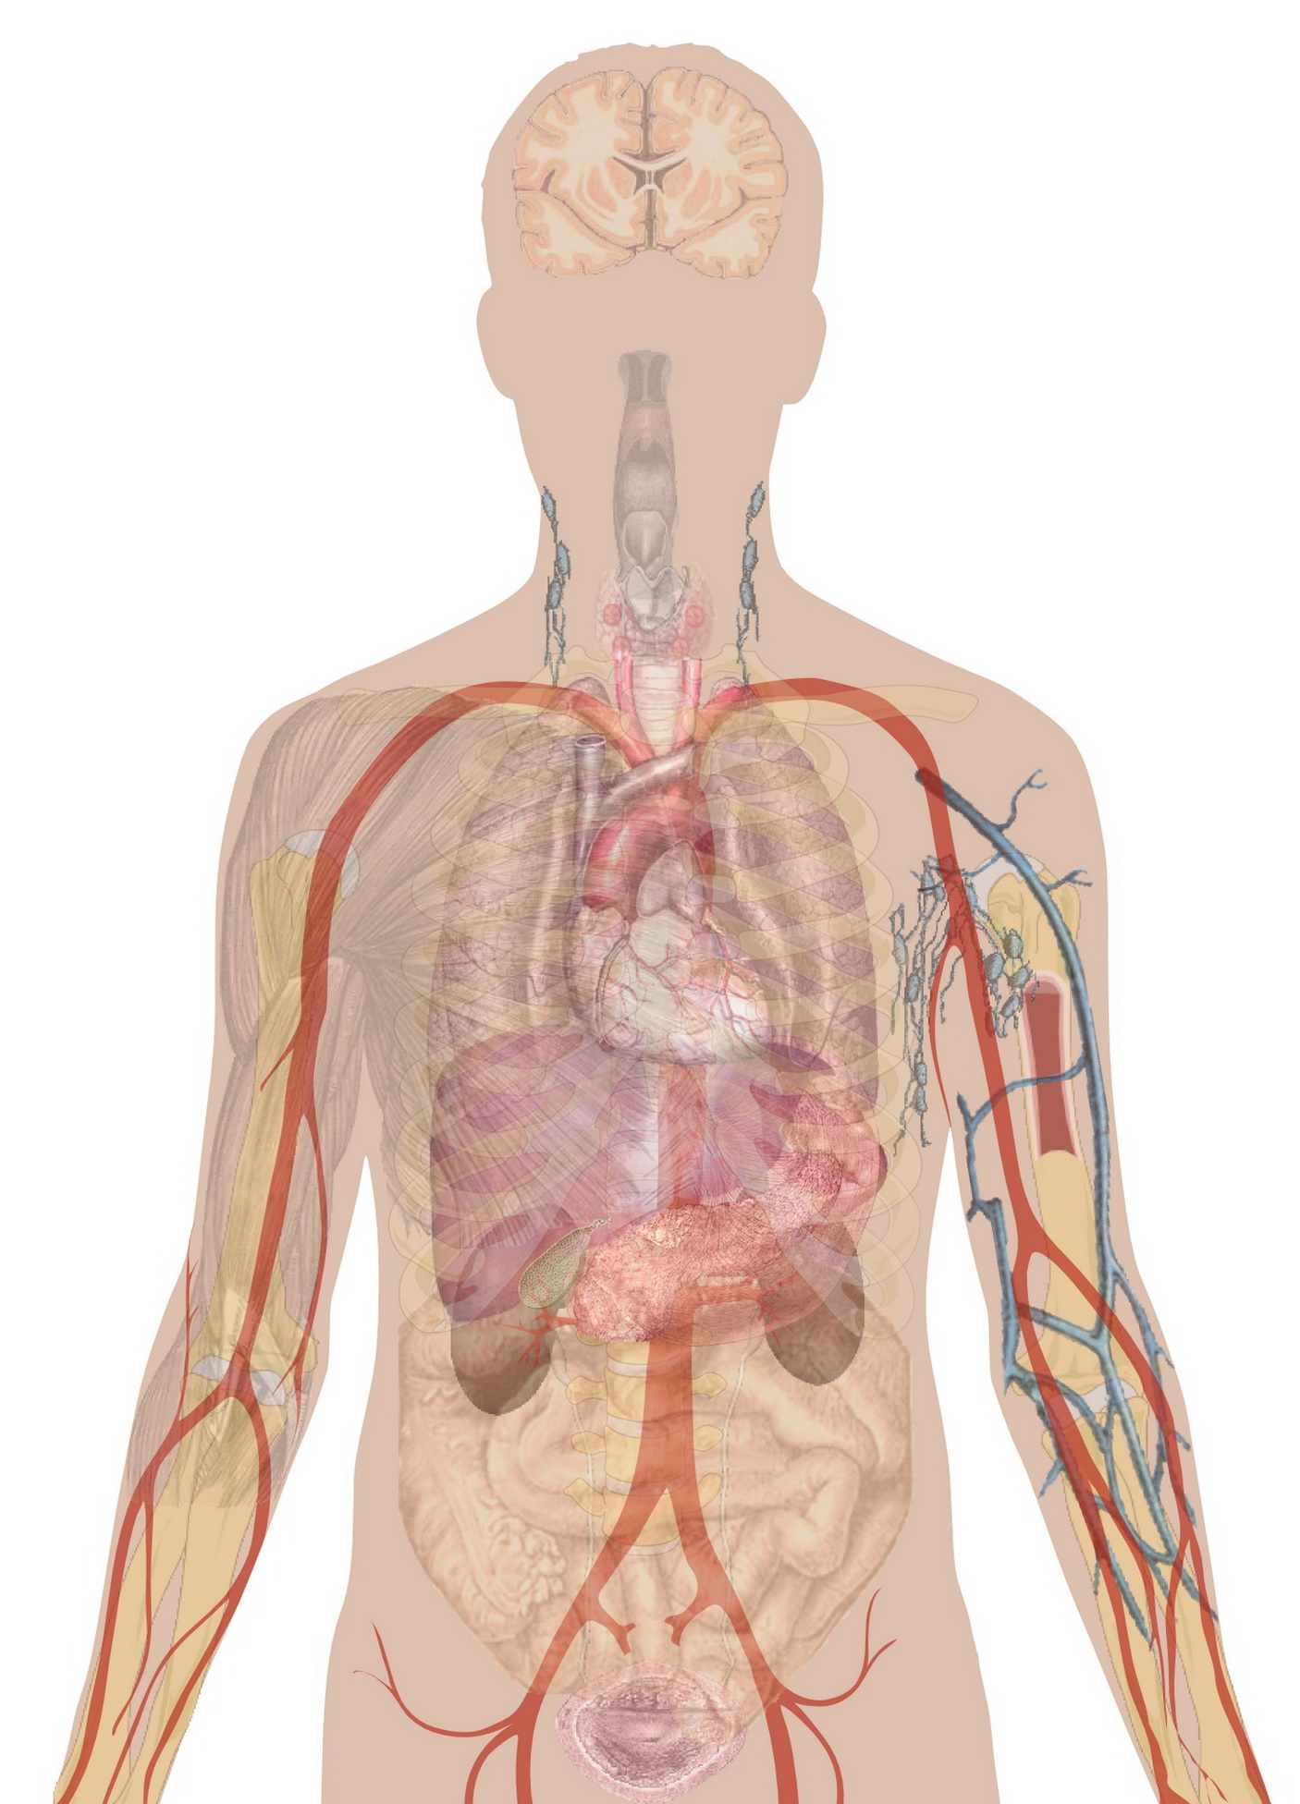
Learning Objectives
CFU
What are we going to learn?
Identify organs in the digestive system
Describe the function of each organ in the digestive system
Activate Prior Knowledge
There are many systems of organs in the human body.
Think, Pair, Share: What are four of the organ systems in the human body?
Think, Pair, Share: The digestive system is made up of different organs. Name three organs in the digestive system.

Slide 6
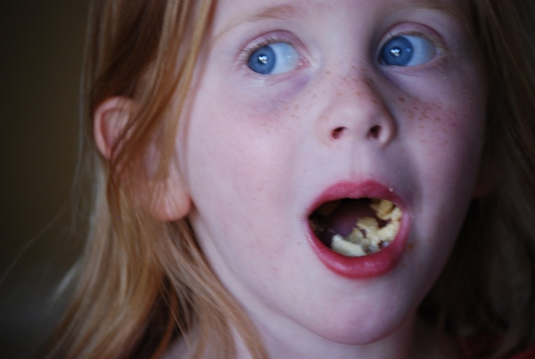
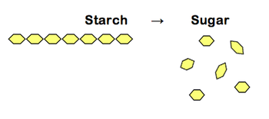
Concept Development
CFU 1
What is digestion?
What is the function of the digestive system
Digestion is the process of breaking down food and drink so their nutrients can be absorbed into the body.
There are two types of digestion:
Physical digestion is breaking down food into smaller pieces without changing the chemical structure of the food - for example chewing.
Chemical digestion uses chemicals (called enzymes) to break down the chemicals in the food – for example breaking starch down into smaller sugars.
CFU 2
What are the two types of digestion?
CFU 3
What are enzymes?
CFU 4
How is physical digestion different to chemical digestion?

Slide 7
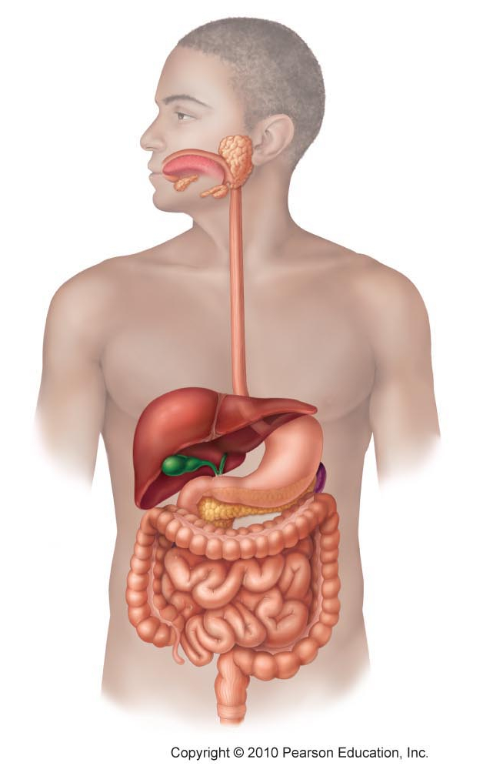
Concept Development
CFU 1
What is the digestive tract?
CFU 2
How does food get into the digestive tract?
The Digestive System – the digestive tract
Food passes through several organs as it is digested this is known as the digestive tract.
Food enters through the mouth
through the oesophagus and into the stomach
This empties into the small intestine
Then into the large intestine
Lastly, it is stored as faeces in the rectum before leaving the body through the anus.
Mouth
Oesophagus
Stomach
Small intestine
Large intestine
CFU 3
Which structure does food pass through to get from the mouth to the stomach?
CFU 5
What is stored in the rectum and how does it leave the body?
Rectum
CFU 4
Which part of the intestine does food go into first?
Anus
Vocabulary
Faeces: poo

Slide 8
Concept Development
CFU 1
What is the role of the liver and pancreas?
CFU 2
How does the gall bladder help the digestive process?
The Digestive System – the support organs
The liver and pancreas produce chemicals that help break down chemicals in the food.
The gall bladder stores chemicals produced by the liver.
Liver
Gall bladder
Pancreas
Vocabulary
Faeces: poo

Slide 9
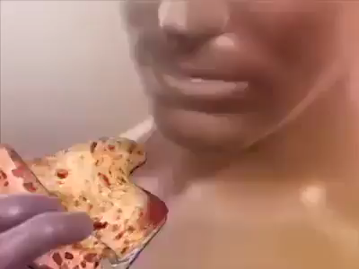

Slide 10
Skill Development
CFU 1
What is the function of the mouth?
CFU 2
What role do teeth play in digestion?
Function of Organs in the Digestive System
Mouth - Food enters the system through the mouth, where teeth bite and grind food into smaller pieces.
Tongue - moves food around and pushes it down the oesophagus.
Mouth
CFU 3
What is the role of the tongue?
Oesophagus
Liver
Gall bladder
Stomach
Pancreas
Small intestine
Large intestine
Rectum
Anus

Slide 11
Skill Development
CFU 1
What is the function of the oesophagus?
CFU 2
How long is food stored in the stomach?
Function of Organs in the Digestive System
Oesophagus - moves food from the mouth to the stomach.
Stomach - food is mixed with stomach acid to help digestion.
Mouth
Oesophagus
Liver
Gall bladder
Stomach
Pancreas
Small intestine
Large intestine
CFU 3
What else happens in the stomach?
CFU 4
Where does the food go next?
Rectum
Anus

Slide 12
Skill Development
CFU 1
What is the function of the liver and pancreas?
CFU 2
Are the liver and pancreas involved in physical or chemical digestion? Explain your choice.
Function of Organs in the Digestive System
liver and pancreas - produce chemicals that are added to the food at the start of the small intestine to help break down the food
Gall Bladder – Stores bile made in the liver and adds it into the small intestine
Small intestine - Absorbs nutrients from food into the blood.
Mouth
Oesophagus
Liver
Gall bladder
Stomach
Pancreas
Small intestine
Large intestine
Rectum
Anus

Slide 13
Skill Development
CFU 1
What is removed by the large intestine?
CFU 2
What else does the large intestine do to the food?
Function of Organs in the Digestive System
large intestine - removes water from the food and compacts it into faeces.
Rectum - stores the faeces until it is released from the body.
Mouth
Oesophagus
Liver
Gall bladder
Stomach
Pancreas
Small intestine
Large intestine
CFU 3
How are the two intestines similar?
CFU 4
What happens in the rectum?
Rectum
Anus

Slide 14
Relevance
Knowing how organs work together in a system and how the systems interact with each other will help you understand how the body works.
Understanding the structure and function of the digestive system will help you understand how we get our energy and nutrition.

Slide 15
Skill Closure
Put the organs of the digestive tract in the correct order.
Stomach, Small intestine, Mouth, Oesophagus, Large intestine, Anus, Rectum
Skill Closure
The liver and the pancreas are not part of the digestive tract, but have a role in digestion. What is their role?
Skill Closure
Harold says chewing is an example of chemical digestion. Is he correct? Explain your choice.

Slide 16
Independent Practice
Collect and complete a hard copy of the digestive system worksheet.
There are two types of digestion:
Physical digestion is breaking down food into smaller pieces, for example chewing, without changing the chemical structure of the food.
Chemical digestion uses chemicals, called enzymes, to break down the chemicals in the food.
Food enters the system through the mouth, where teeth bite and grind food into smaller pieces.
The tongue moves food around and pushes it down the oesophagus.
The oesophagus moves food from the mouth to the stomach.
The stomach stores food for about 3 hours. The food is mixed with stomach acid to help digestion.
The food then moves into the small intestine.
Chemicals produced by the liver and pancreas are added to the food at the start of the small intestine.
The chemicals help break down food.
As the food passes through the small intestine, nutrients are extracted.
The large intestine removes water from the food and compacts it into faeces.
The rectum stores the faeces until it is released through the anus.

